Slide 1
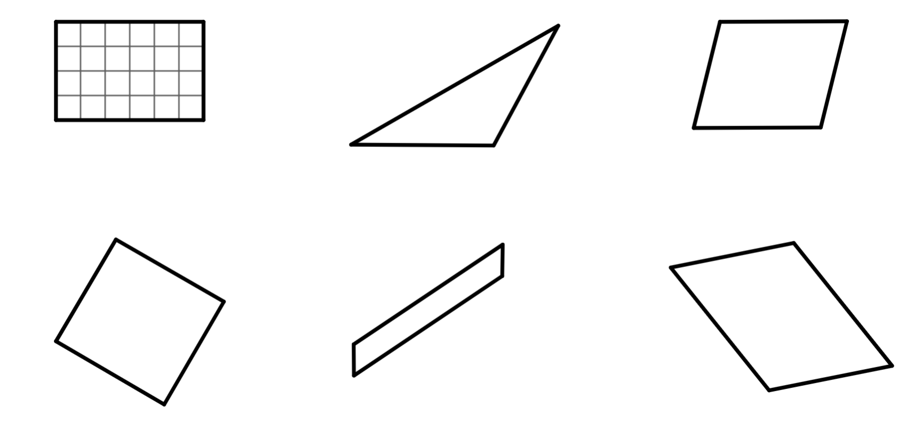
Checking understanding of area
Task A: Areas of rectangles, triangles and parallelograms
Find the area of each shape.
a)
b)
7 cm
4 cm
5 cm
area = 24 units²
area = 10 cm²
c)
d)
8 mm
10 cm
9 cm
8 mm
9 mm
11 cm
area = 90 cm²
area = 64 mm²
e)
15 cm
f)
1 cm
7.5 m
12 m
9 m
18 cm
6 m
area = 15 cm²
area = 54 m²

Slide 2
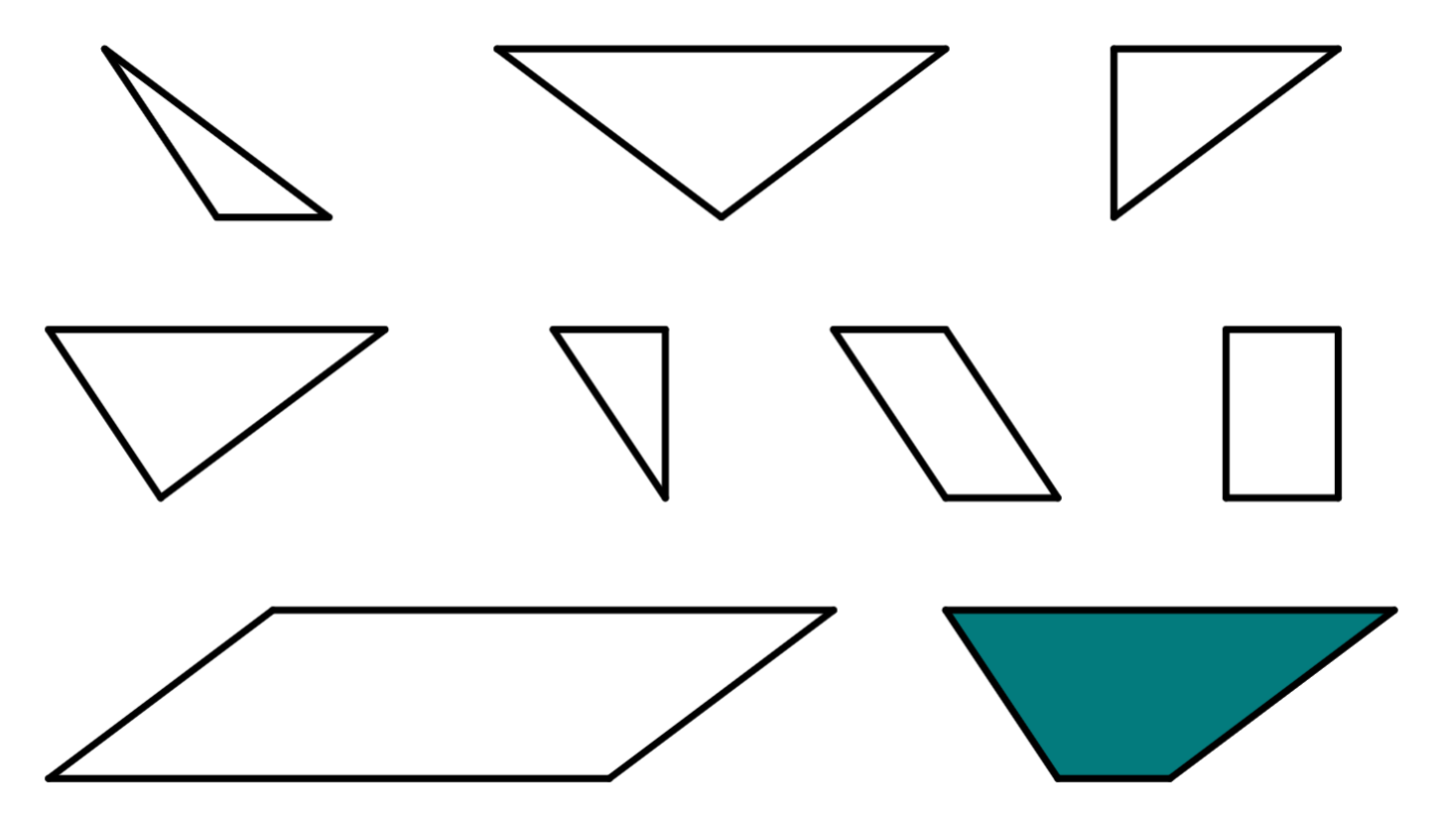
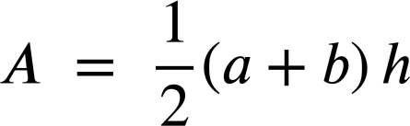
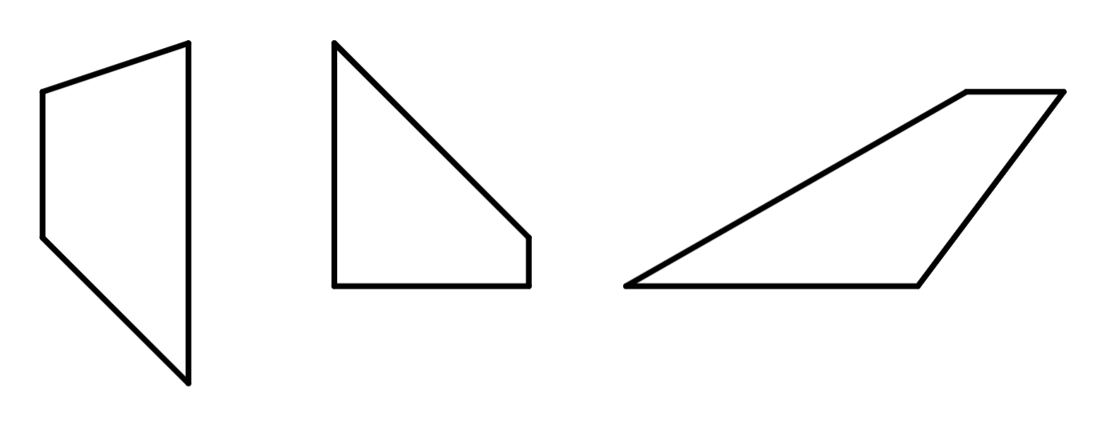
Checking understanding of area
Task B: Areas of trapezia
1) The letters inside each shape represents its area.
a) Use each letter once to fill in the gaps in the calculations. Multiple solutions exist.
Possible solution:
T = F + B + D
T = C + E
T = G + H
T = A ÷ 2
2
T
3
A
3
8
10
3
B
3
C
3
D
E
3
2
2
2
2
6
For other alternatives, find the area of each shape and check that all the calculations give 15.
3
H
F
G
3
3
b) Find the value of T.
4
8
T = 15 units²
2) All of the shapes below are trapezia.
Use the formula or any other method to calculate the area of each
trapezium.
For a trapezium with parallel sides a and b:
a)
6 cm
b)
c)
4 cm
4 cm
5 cm
7 cm
3 cm
1 cm
3 cm
2 cm
4 cm
4 cm
16 cm²
10 cm²
15 cm²
‹#›

Slide 3
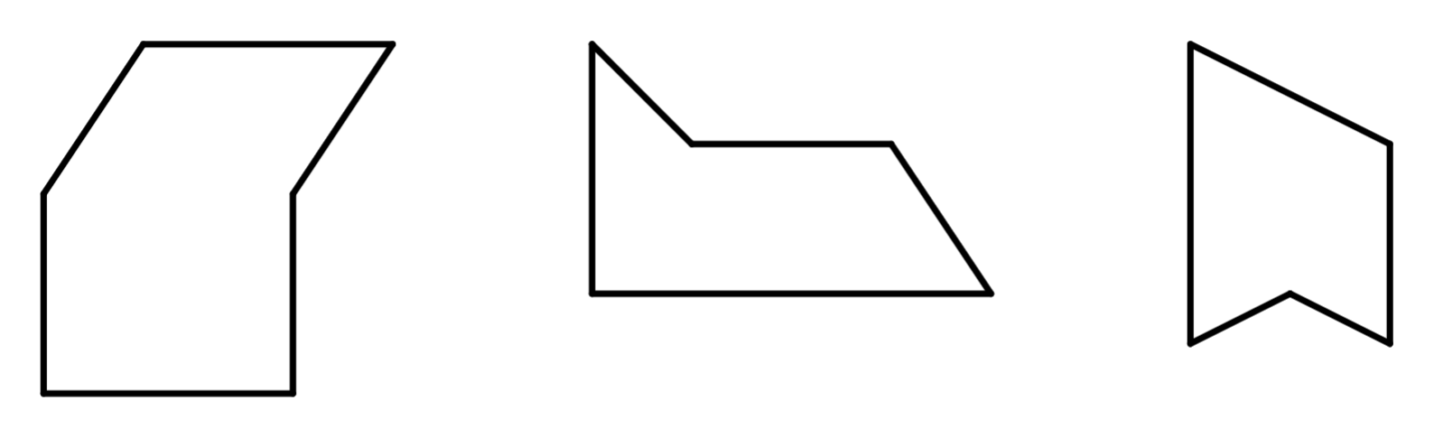
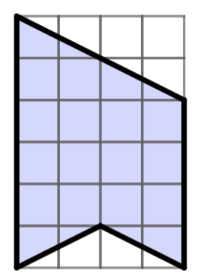
Checking understanding of area
Task C: Areas of composite shapes
1) Find the area of each composite shape.
a)
b)
2 mm
4 mm
7 cm
5 mm
3 mm
4 cm
8 mm
5 cm
35 cm²
23 mm²
c)
1 cm
1 cm
18 cm²
Mathematics in Education and Industry
v2.3

